Slide 1
R Shiny Project
-- Violations in Boston
By: Cassandra Jones
NYC Data Science Academy

Slide 2

Introduction of data
I would like to know the safety in Boston since I’m staying in MA during Covid-19 pandemic
Data are released by Boston Police Department: https://data.boston.gov/dataset/crime-incident-reports-august-2015-to-date-source-new-system
Boston Government named the data “CRIME INCIDENT REPORTS”

Slide 3

Data cleaning
Combined data from 2016 – 2019
2016: 99,430 rows
2017: 101,338 rows
2018: 98,888 rows
2019: 245,004 rows
There are 544,660 rows with 19 columns

Slide 4
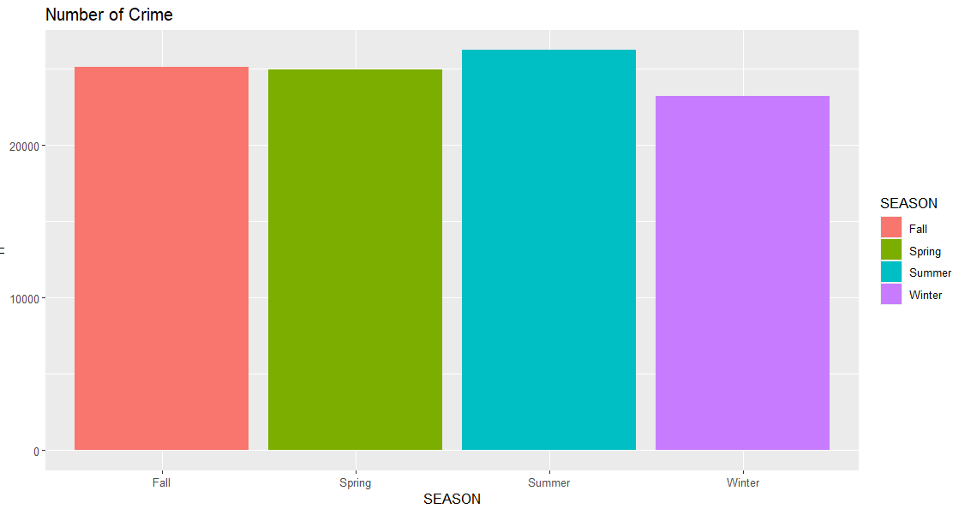
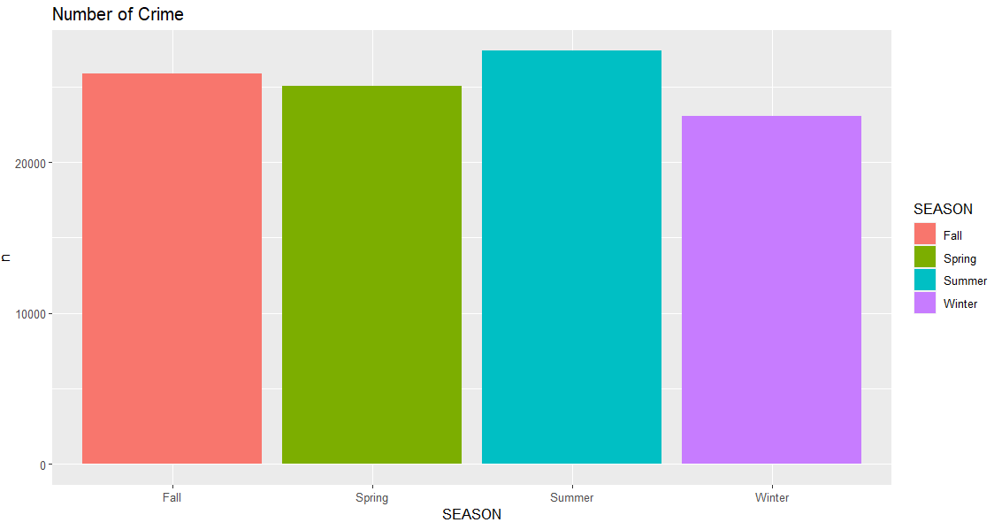
Violations by season and year
Data contains month of each violation
Create a new column “season”
2016 vs 2017 trend

Slide 5
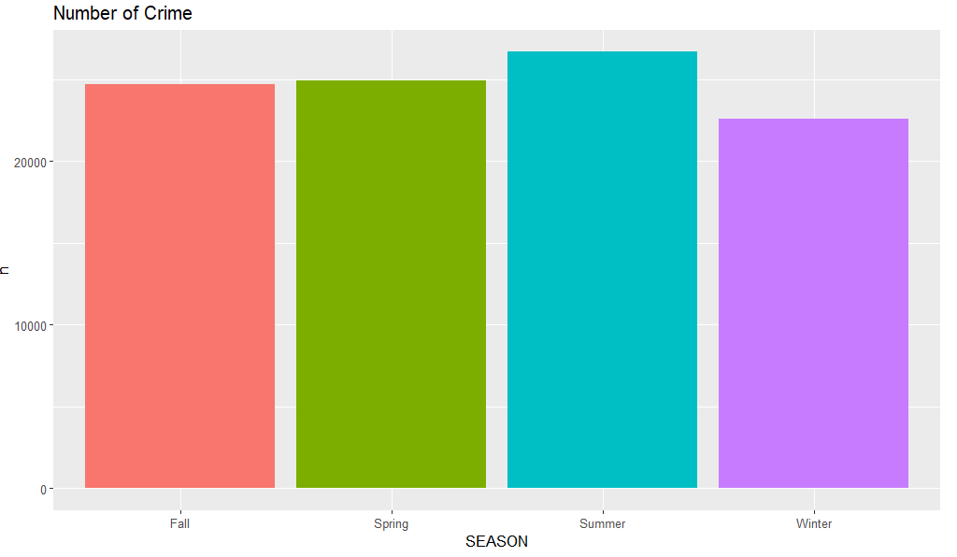
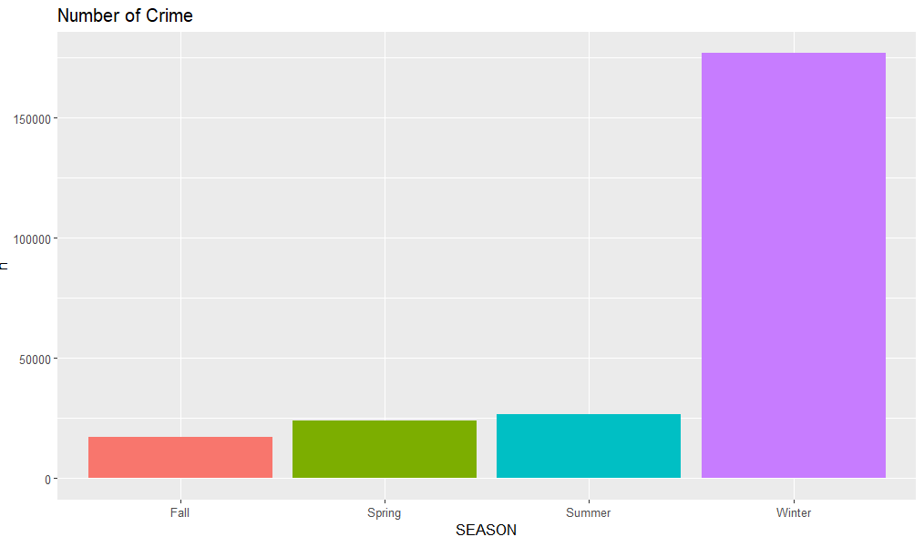
Violations by season and year
2018 vs 2019 trend
Number of violation in 2019 winter is extremely high

Slide 6
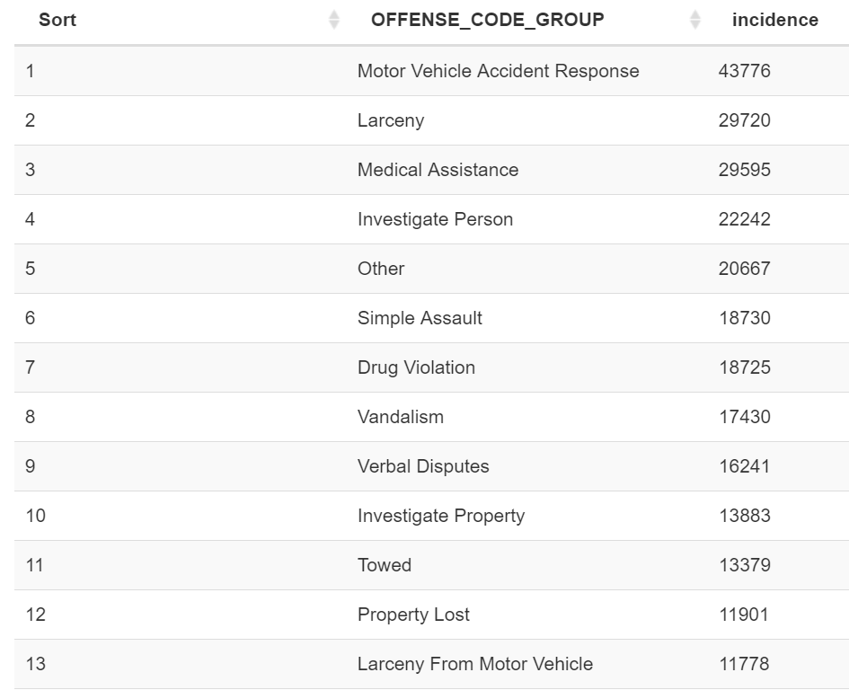
Number of incidence
What happens the most?

Slide 7
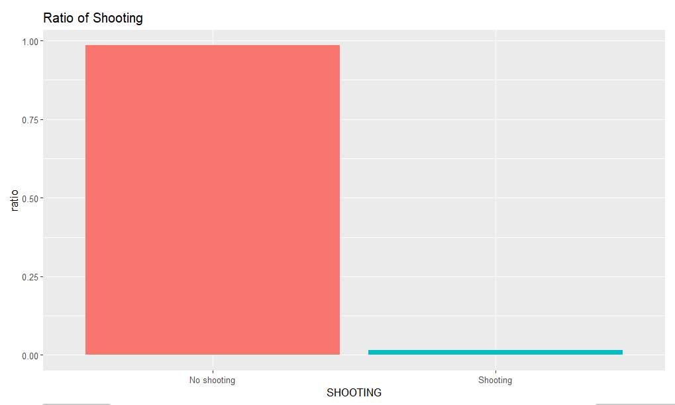
shooting
Original data has a column “shooting” with values 1 and 0
1: yes, 0: no
Convert 1 and 0 to “shooting” and “no shooting”
Insert “unknown” to null value
Ratio of Shooting: 0.004768

Slide 8
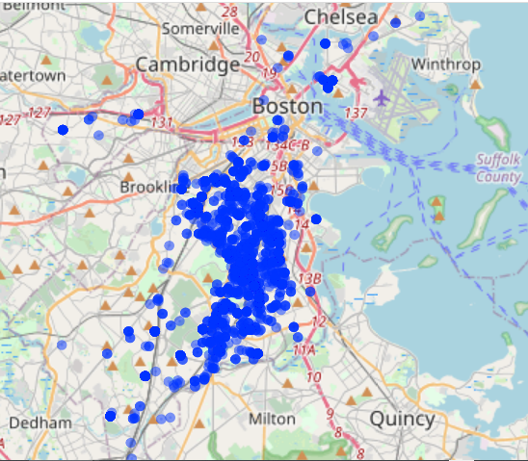
Shooting
Data contains latitude and longtitude
Use library “leaflet” to point the location of each incidence on map

Slide 9
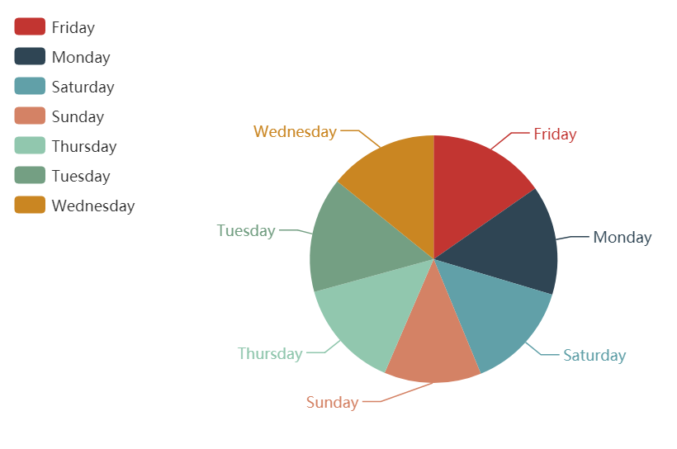
Count by day
Which day of the week has the highest frequency

Slide 10
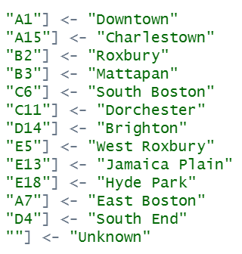
district
Data contains a column of “district”
Values are district codes
Convert codes to name of the districts

Slide 11
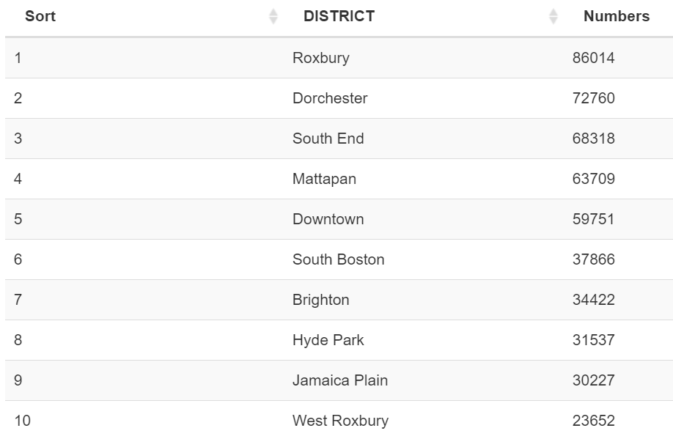
district
Top 10 districts with the highest numbers of violations

Slide 12

summary
There will be more things to be analyzed if data contains more information such as number of injury

